Slide 1
PMI Case Study
Kamaldeep Singh

Slide 2
Agenda
- Introduction
- Exploratory Data Analysts(EDA)
- Preprocessing
- Q1
- Q2 - Problem Formulation
- Q2 - Modelling & Results
- Q3
- Future Work

Slide 3
Introduction

Slide 4
Problem
For this data science challenge, you are provided with a dataset containing mobility traces of ~500 taxi cabs in San Francisco collected over ~30 days. The format of each mobility trace file is the following - each line contains [latitude, longitude, occupancy, time], e.g.: [37.75134 -122.39488 0 1213084687], where latitude and longitude are in decimal degrees, occupancy shows if a cab has a fare (1 = occupied, 0 = free) and time is in UNIX epoch format.
The goal of this data science challenge is twofold:
1. To calculate the potential for a yearly reduction in CO2 emissions, caused by the taxi cabs roaming without passengers. In your calculation please assume that the taxicab fleet is changing at the rate of 15% per month (from combustion engine-powered vehicles to electric vehicles). Assume also that the average passenger vehicle emits about 404 grams of CO2 per mile.
2. To build a predictor for taxi drivers, predicting the next place a passenger will hail a cab.
3. (Bonus question) Identify clusters of taxi cabs that you find being relevant from the taxi cab company point of view.

Slide 5
Evaluation criteria
Exploratory data analysis
Preprocessing
Modeling techniques that you used to build your predictor
The metrics and methods used to quantify the performance of your prediction
Coding Practices:
We try and follow coding principles like DNR and PEP-8 guidelines as much as possible.

Slide 6
Data
The training data consists of mobility traces of 537 taxi cabs in San Francisco collected over ~30 days making a large dataset.
We limit our analysis to ~100 taxi cabs due to infrastructure constraints .
0 - 55.29%
1 - 44.70%

Slide 7
Exploratory Data Analysis(EDA)

Slide 8
Pandas-profiling and sweetviz py packages
(Don’t reinvent the wheel)
We used some external py packages like `pandas-profiling` and `sweetviz` to expedite our Exploratory Data Analysis. They provide
- Quantile and descriptive statistics
- Feature properties like Cardinality, Missing values and number of Zeros
- Interactions: the relationship between two variables in the data frame as scatter plots.

Slide 9
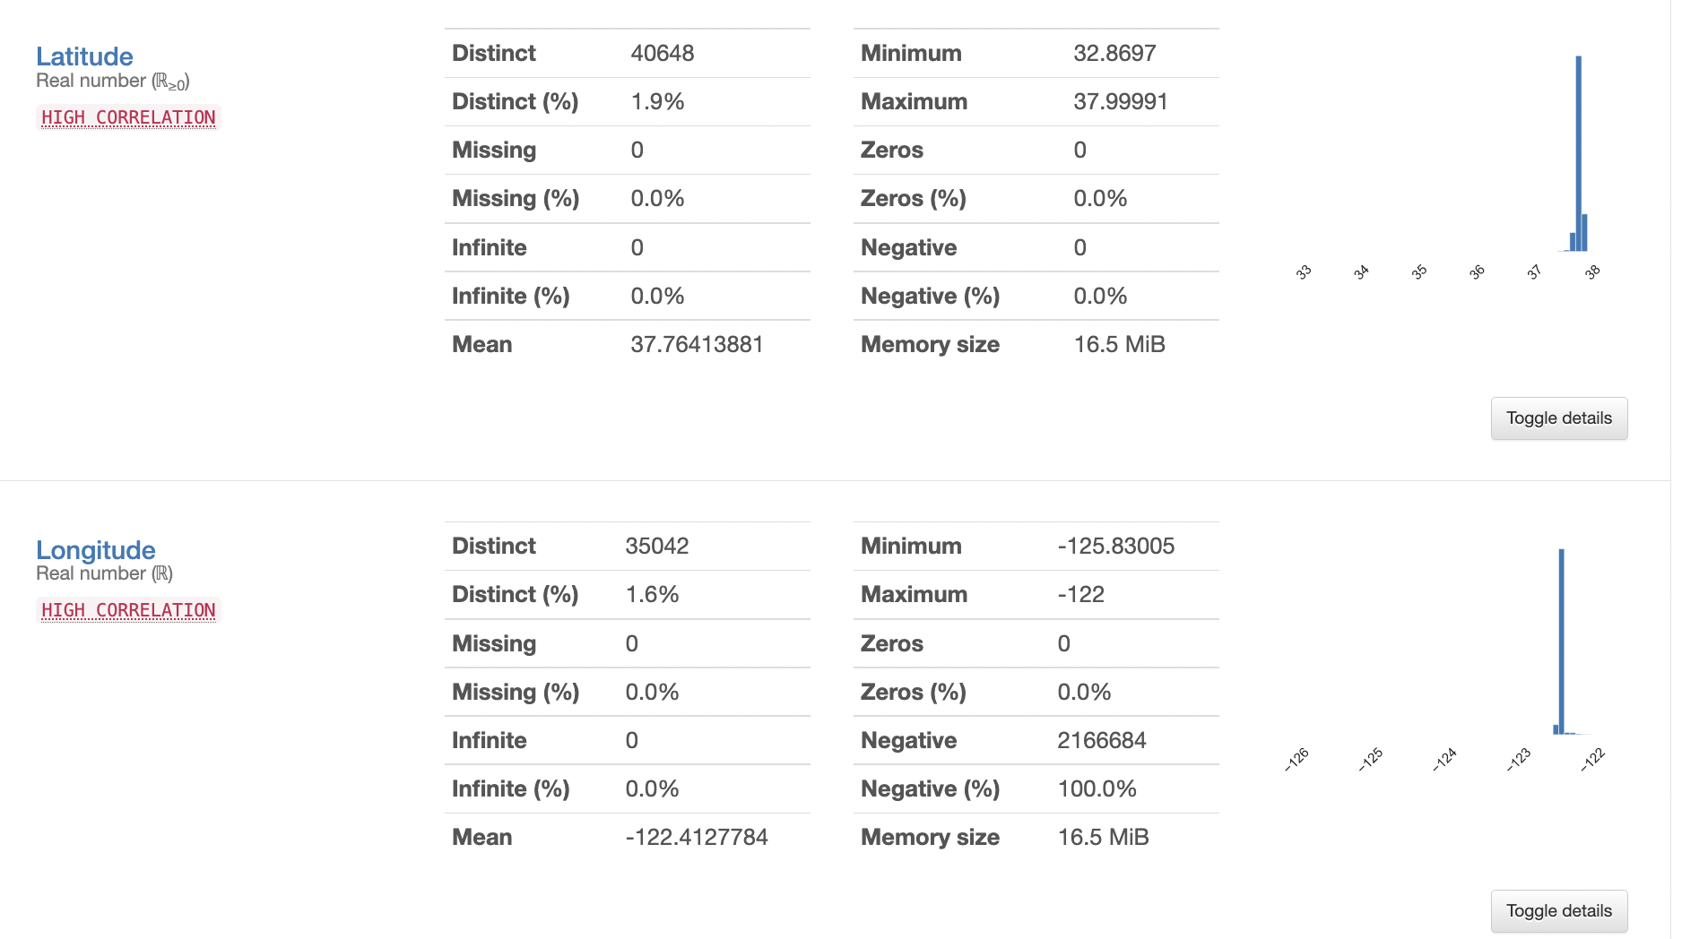
Pandas-profiling

Slide 10
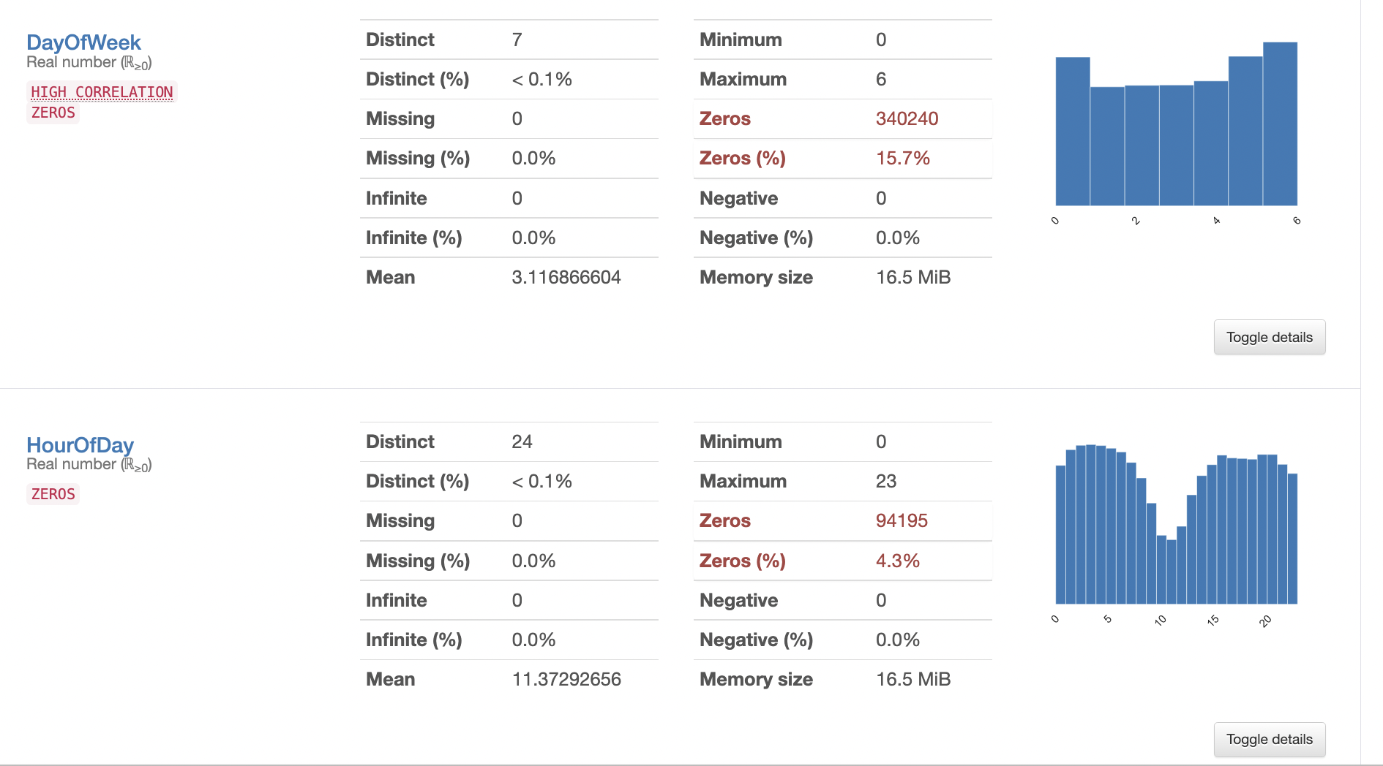
Pandas-profiling

Slide 11
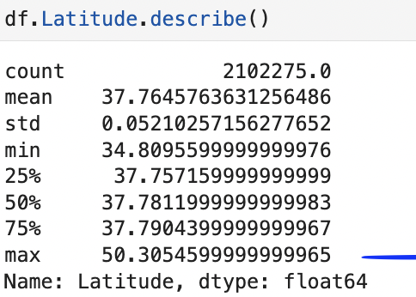
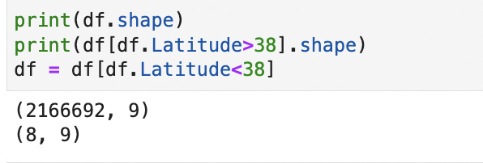
Outlier Detection
Max Latitude was quite high - so we keep latitude under 38 and removed 8 rows

Slide 12
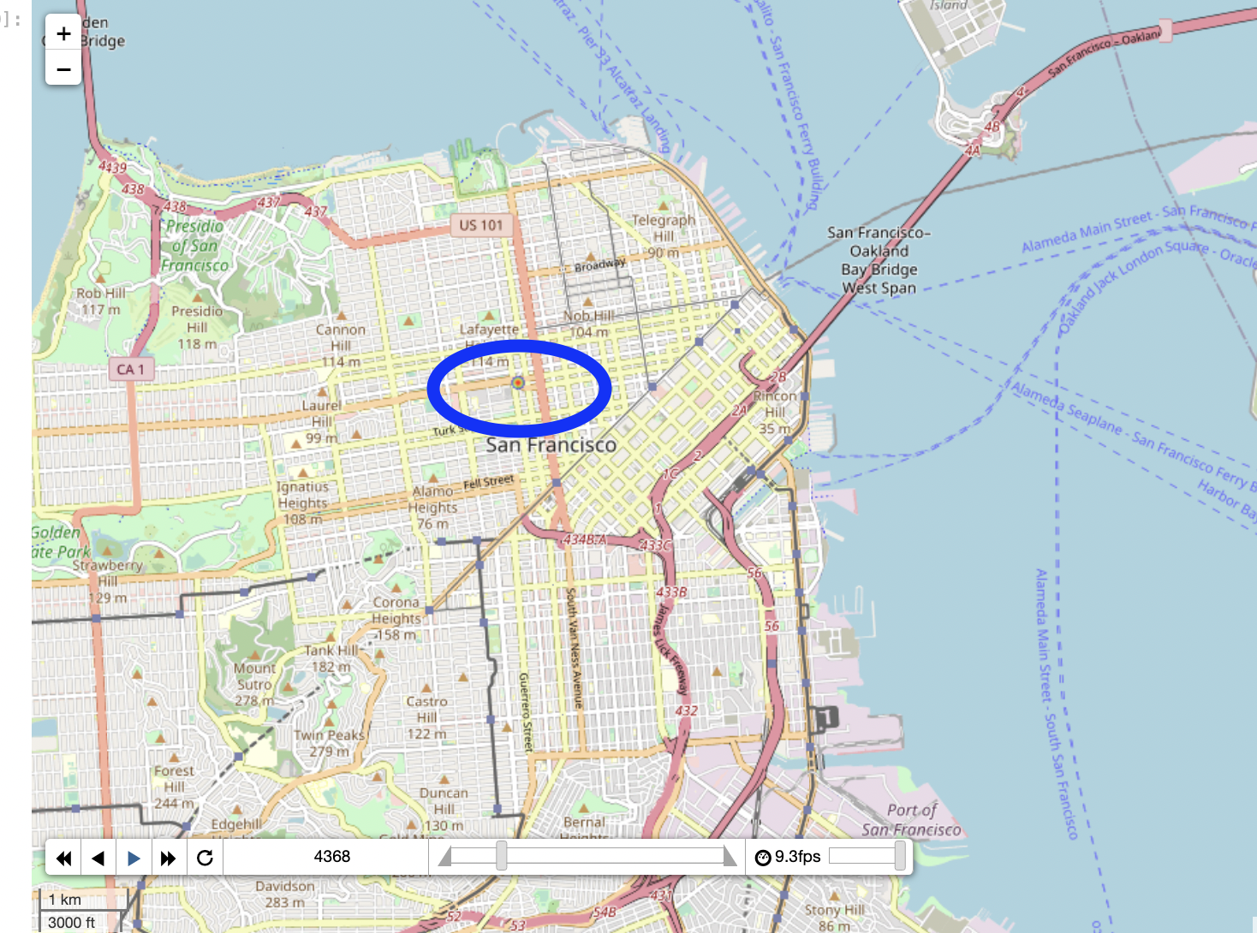

Slide 13
Q1 - Carbon Reduction

Slide 14
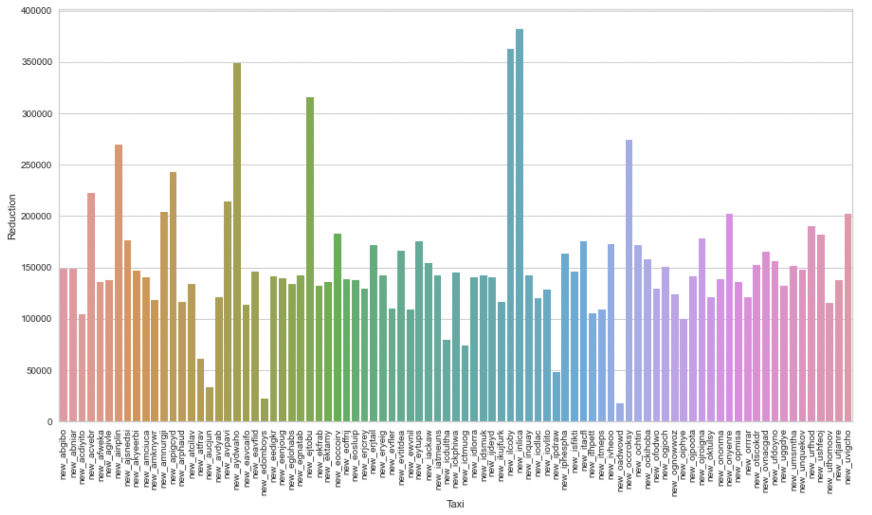
CO2 Reduction
- Taxicab fleet is changing at the rate of 15% per month (from combustion engine-powered vehicles to electric vehicles).
- Average passenger vehicle emits about 404 grams of CO2 per mile.
Calculate Lag
Haversine Distance
CO2 Estimation based on average emission
Compute compounded month on month reduction at 15%
Compute yearly reduction

Slide 15
Q2 - Problem Formulation

Slide 16
Formulation as a Machine Learning problem
Build a predictor for taxi drivers, predicting the next place a passenger will hail a cab
1. Predict the longitude and latitude given past longitude and latitude with multivariate time series model like vector autoregressive models (VAR)
Possible cons are if this is a vehicle routing problem you won’t be looking at a point that’s too far from distance perspective even if the demand for passengers is high there
2. There could be perhaps other better indicators that affect the demand for a taxi like time of the day, day of the week/month which explored during the feature engineering phase showed promising. Thus we proceed with a Classification approach whereby we use time factors to train the model to predict occupancy and then generate test sets from the given location of a taxi to predict where should the next place be where a passenger is likely to hail a cab

Slide 17
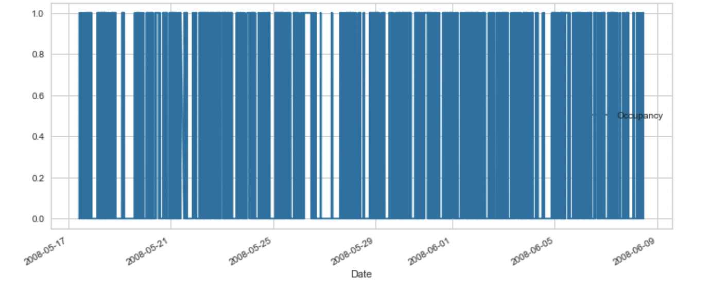
Formulation as a Machine Learning problem
Time scale is too granular for occupancy so Regression is likely to be noisier

Slide 18
Approach/ Methodology
-
EDA
Preprocessing
Feature Engineering
Modelling
Model Evaluation
Explainability
(SHAP)

Slide 19
Preprocessing
- No encoding required - All data is numerical
- Convert timestamp to datetime
- Feature Scaling is required for KNN
- Outlier detection was basic but can be improved by InterQuartile Ranges (Tukey’s)

Slide 20
Feature Engineering
Time features:
DayOfWeek
DayOfMonth
HourOfDay
MinuteOfHour
Location features:
Whether location is a hotspot or not

Slide 21
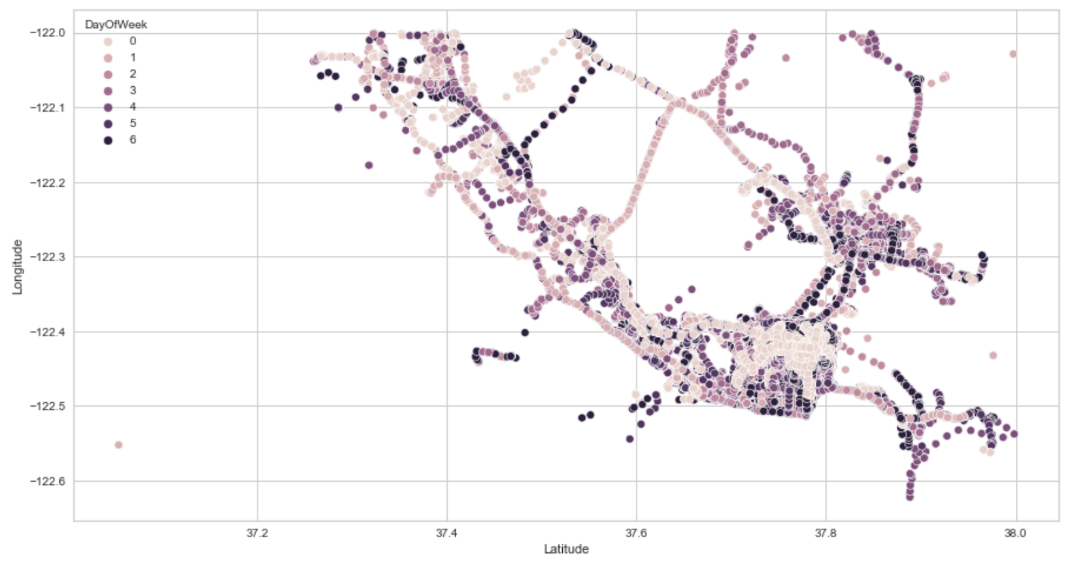
Feature Engineering - Day of the week

Slide 22
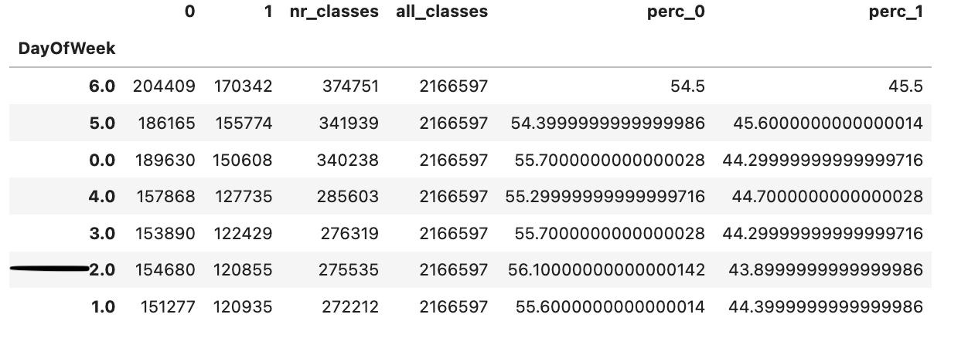
Feature Engineering - Day of the week

Slide 23
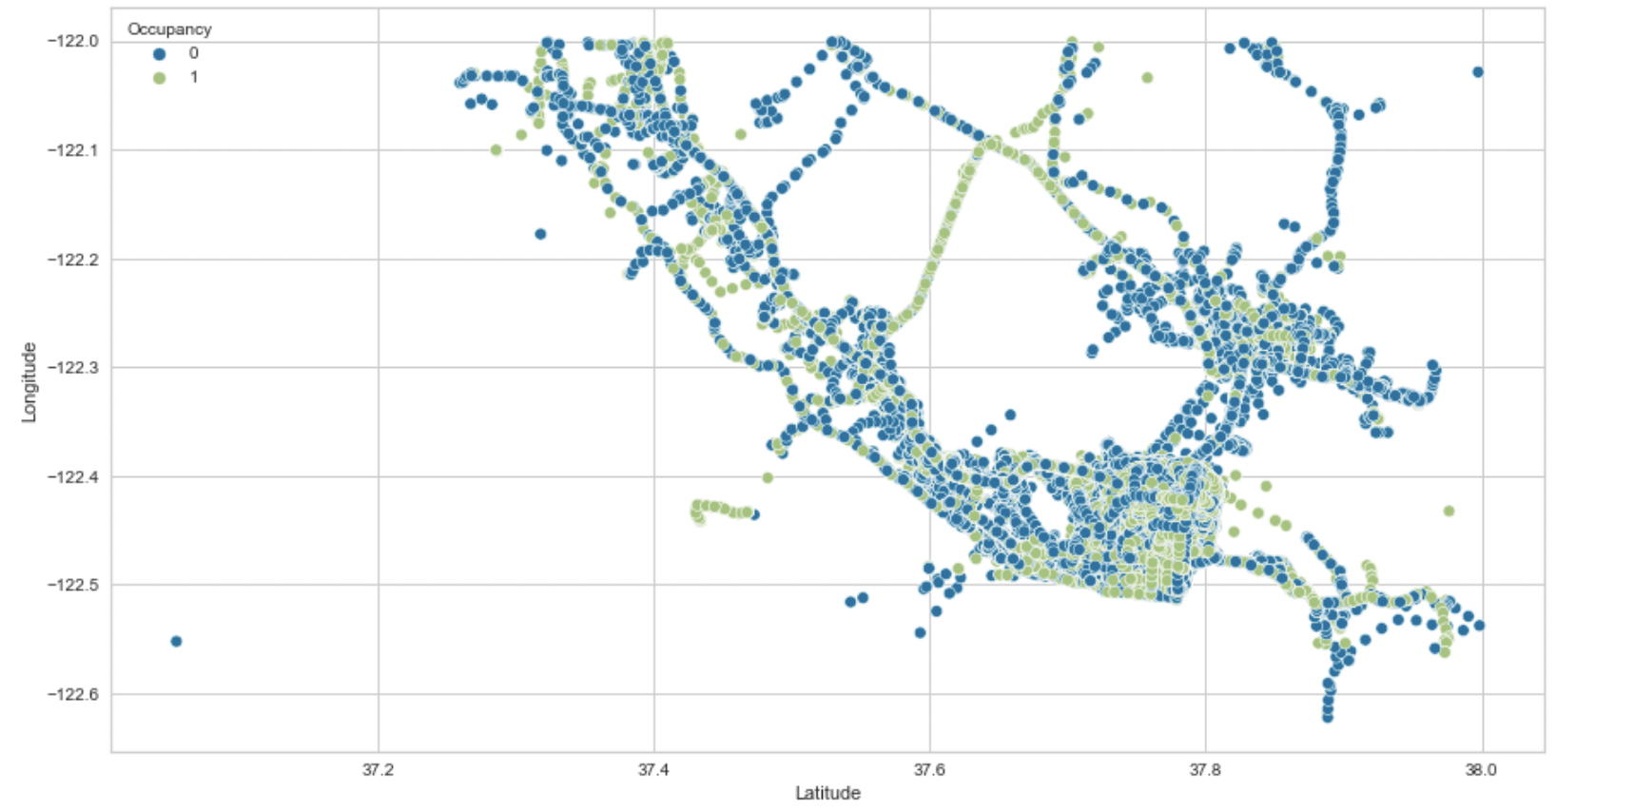
Feature Engineering - Occupancy hotspots

Slide 24
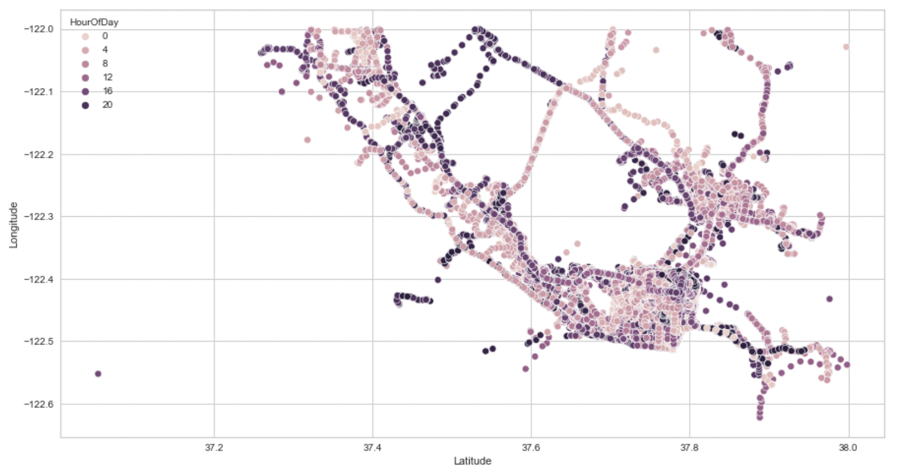
Feature Engineering - Occupancy hotspots

Slide 25
Q2 - Modelling & Results

Slide 26
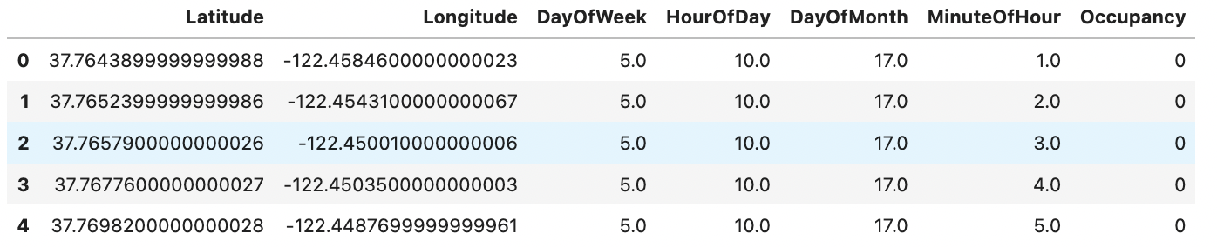
Modelling & Results

Slide 27
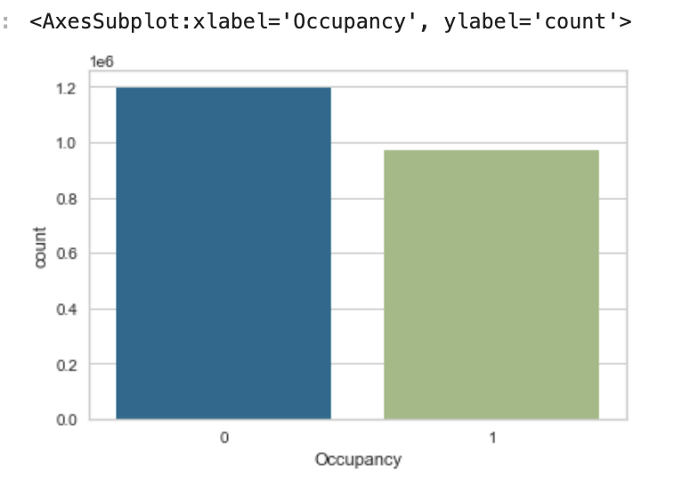
Modelling & Results
Models that we consider:
KNN
XGBoost
KNN is chosen because it can measure distance between
- Cons - We won’t get probability on the predicted target.
class_weights are applied to the models

Slide 28
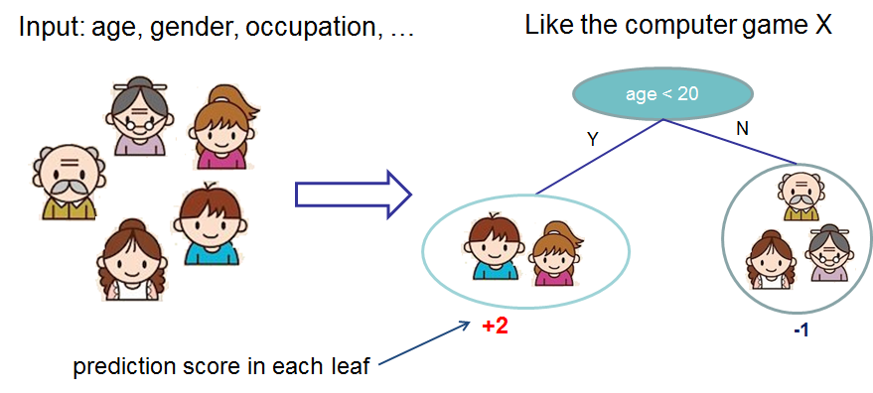
XGBoost
*from XGBoost official Documentation

Slide 29
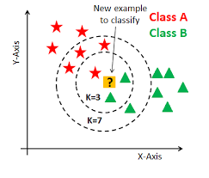
KNN

Slide 30
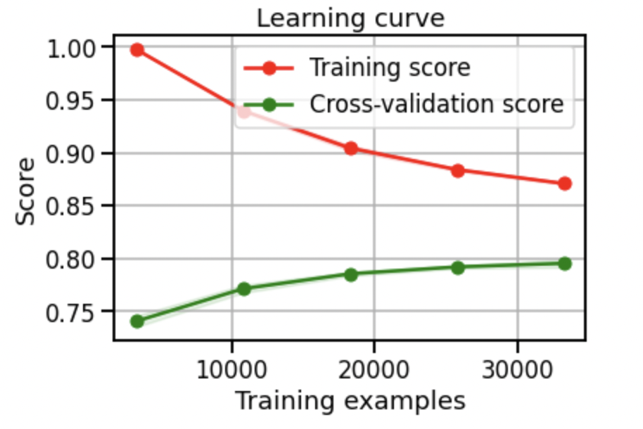
Check if the model overfits/underfits
JUST AN EXAMPLE - not computed

Slide 31
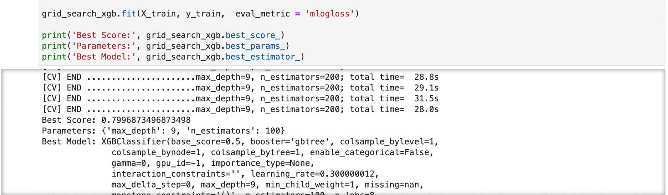
GridSearch - Hyperparameter tuning
Find the optimal parameters for the model
- Time consuming
max_depth
N_estimators
K - KNN
Notes:
The number of trees (or rounds) in an XGBoost model is specified to the XGBClassifier or XGBRegressor class in the n_estimators argument. The default in the XGBoost library is 100.
Generally, boosting algorithms are configured with weak learners, decision trees with few layers, sometimes as simple as just a root node, also called a decision stump rather than a decision tree. The maximum depth can be specified in the XGBClassifier and XGBRegressor wrapper classes for XGBoost in the max_depth parameter. This parameter takes an integer value and defaults to a value of 3.

Slide 32
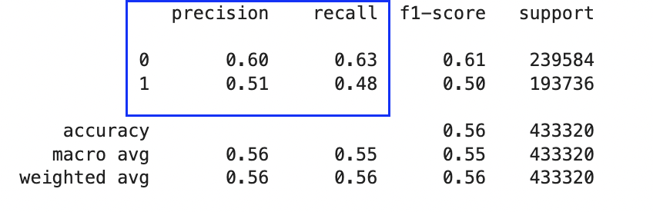
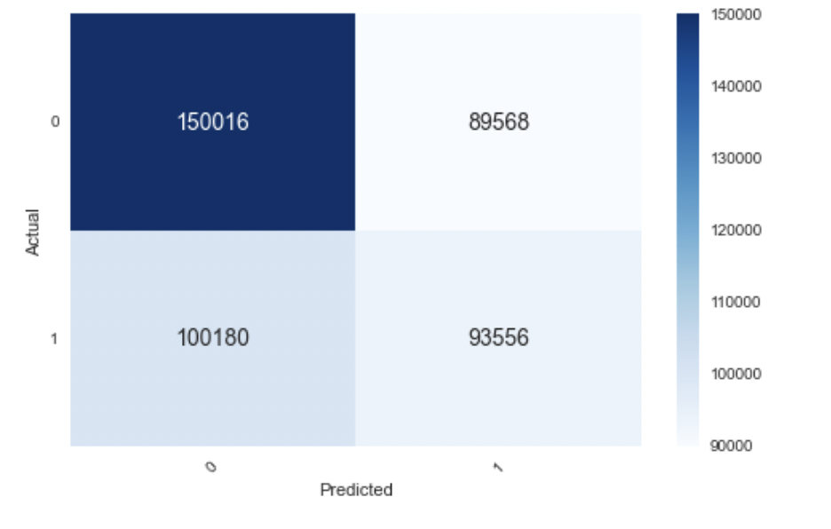
Results

Slide 33
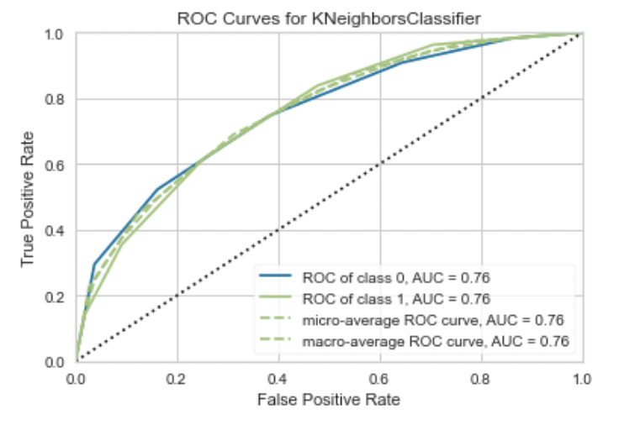
AUROC curves
Model is not good at distinguishing b/w classes
Notes:
When AUC is 0.7, it means there is a 70% chance that the model will be able to distinguish between positive class and negative class.

Slide 34
Results
Routing logic:
1. Given a lat long or the current lat long of the taxi
2. Maximum km - (1-50 km), step = 1km
3. Bearing/Direction - (0-360 degrees) - 0, 90, 180, 270, 360
4. Time and location factors
Generate a set of test data for the model and predict where the passenger is likely to hail a cab from the pre trained model.
Notes:
Does it take same time to repair

Slide 35
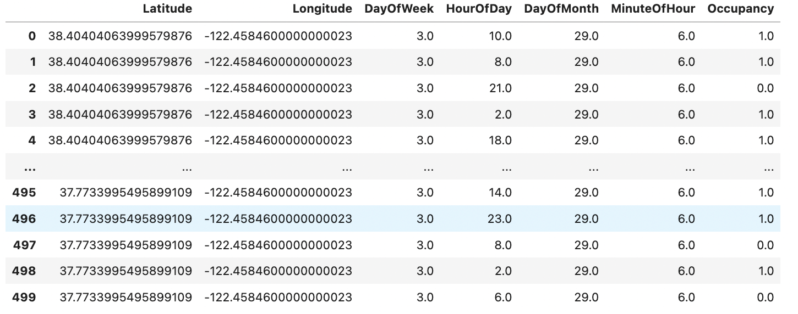
Results
Notes:
Does it take same time to repair

Slide 36
Roadmap / Future Work

Slide 37
Roadmap
- Build location features.

Slide 38
Future work
- Improve Prediction logic with more features and Hyperparameter Tuning
- Figure out why model is not well trained using SHAP
- Modularize the code
- Causality Analysis measuring the relationship between feature and target
Causal Interpretation of Black-Box Models - Stanford
PDP and ALE plots
Verify results with an expert of the domain knowledge

Slide 39
Q3

Slide 40
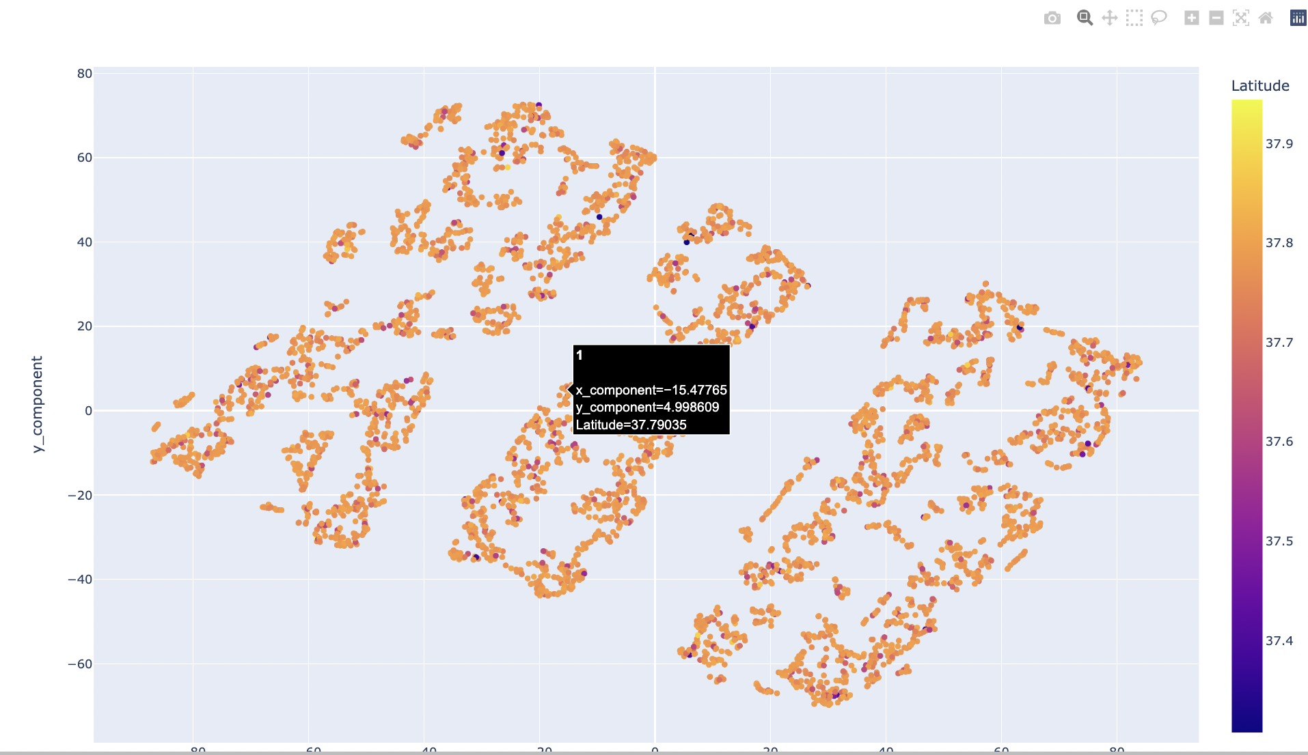
Model and Results with DBSCAN

Slide 41
Appendix

Slide 42

Model Explainability

Slide 43
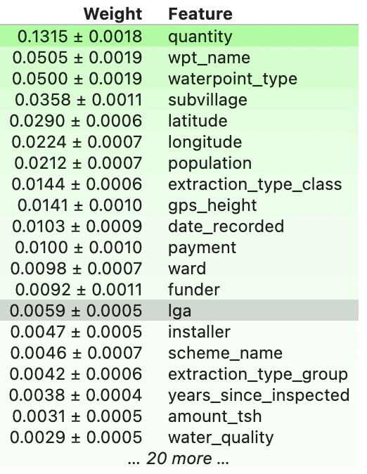
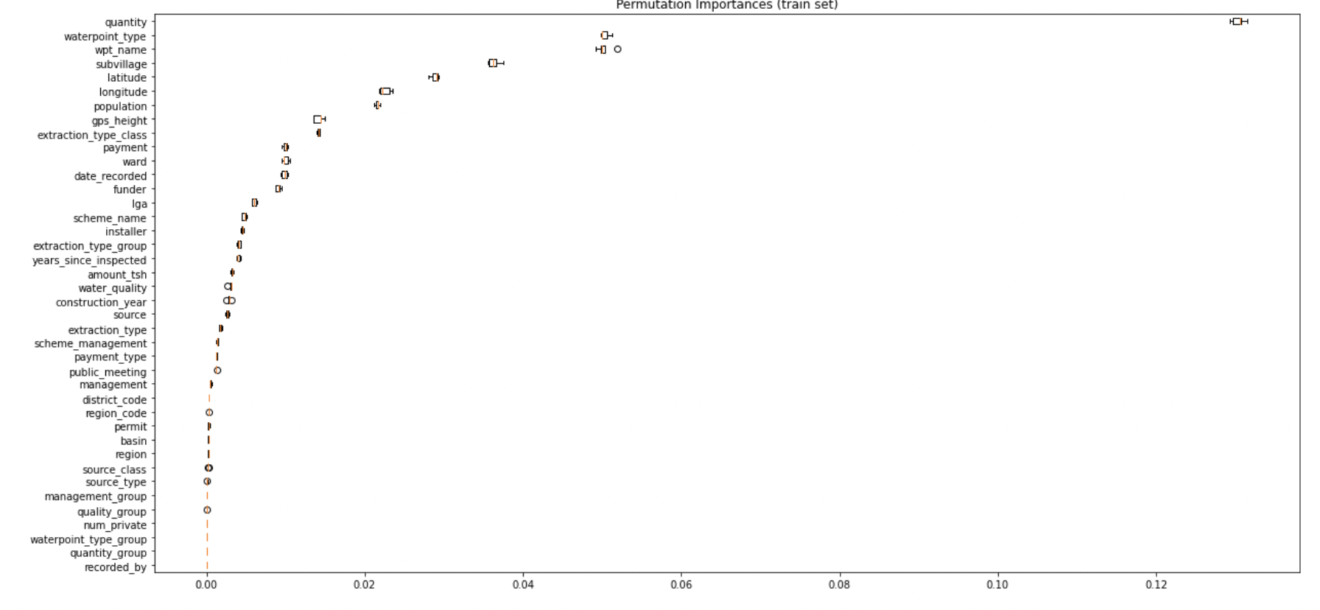
Permutation Importances

Slide 44
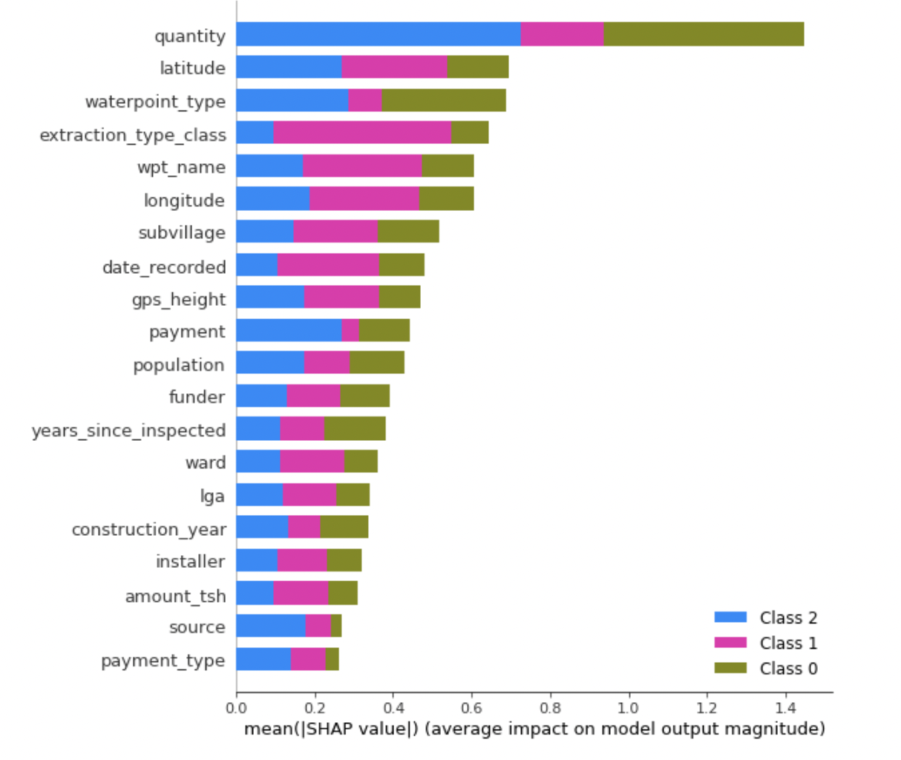
SHAP - Summary for all classes
Notes:
Horizontal location shows whether the effect of that value caused a higher or lower prediction.
How much was a prediction driven by the fact that the team scored 3 goals, instead of some baseline number of goals.

Slide 45
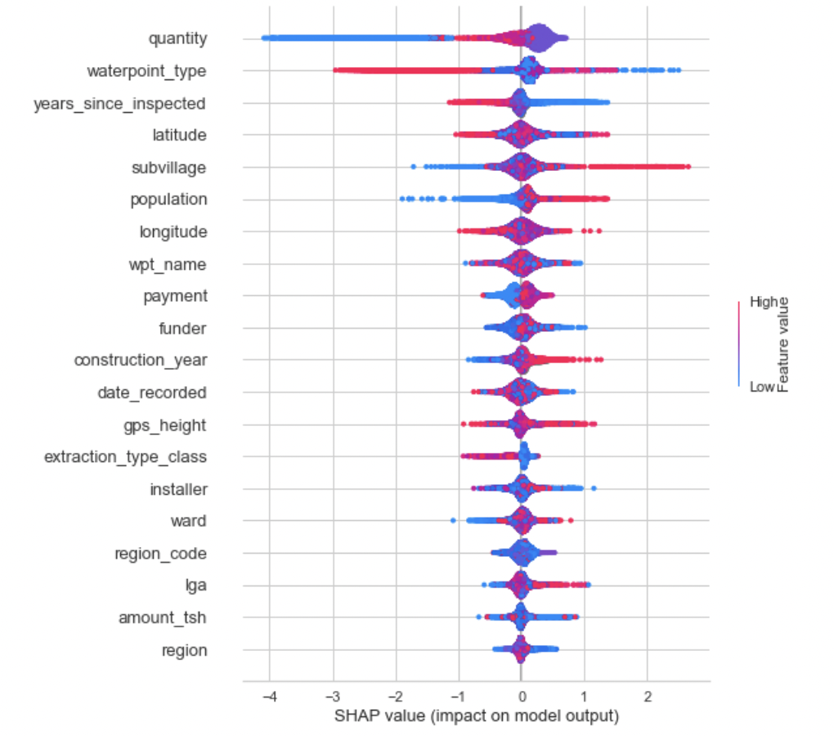
SHAP - decision plots
Notes:
how each feature contributes to the overall prediction
Ideally more spread

Slide 46
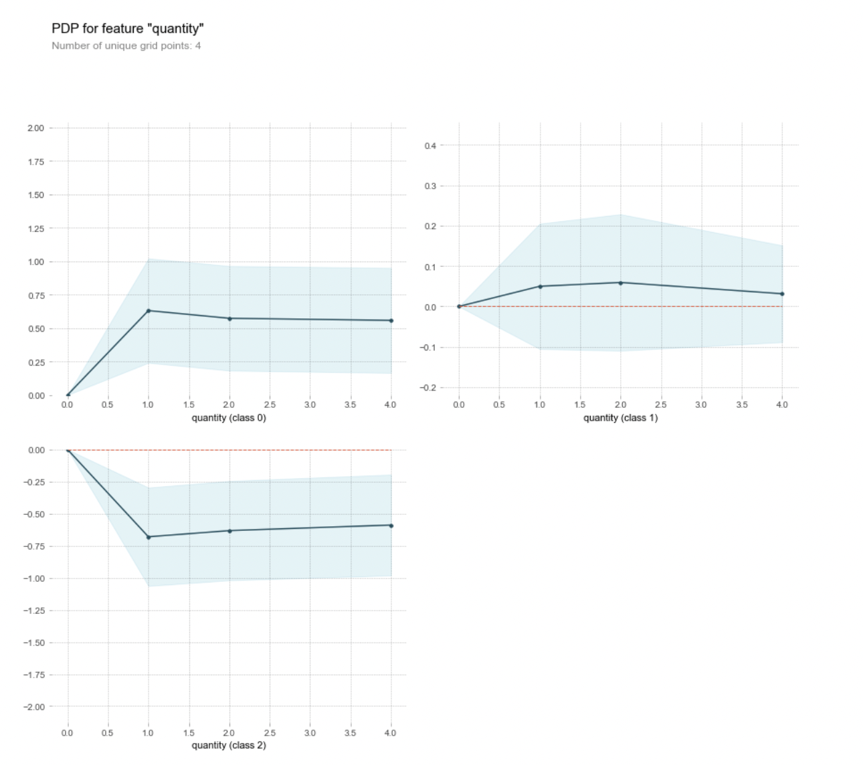
PDP plots
Notes:
The y axis is interpreted as change in the prediction from what it would be predicted at the baseline or leftmost value.
A blue shaded area indicates level of confidence

Slide 47
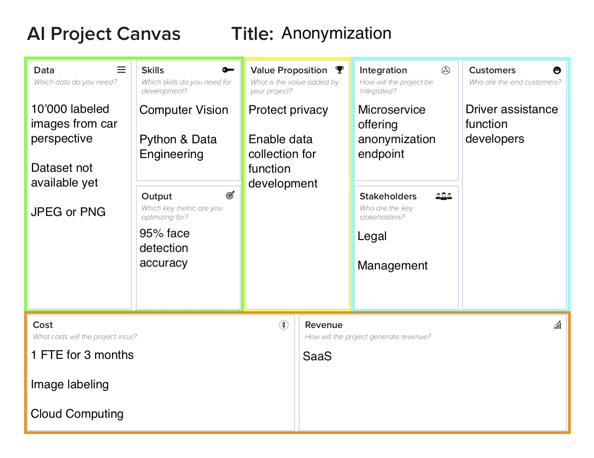
Solution Canvas

Slide 48
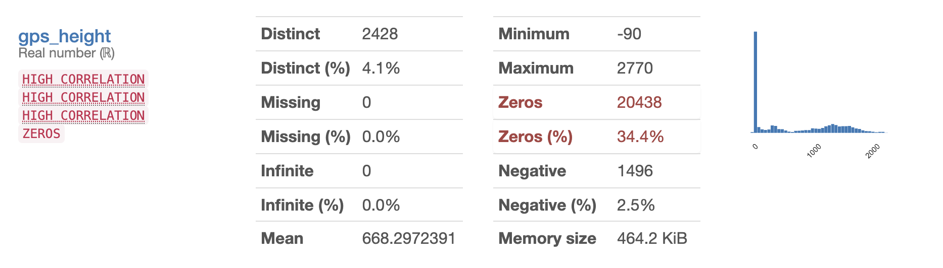
Future work
GPS data could be enriched
2. Improve Prediction logic with more features and Hyperparameter Tuning
3. Tidy up code a bit more - break Models notebook into smaller modules.

